Slide 1
CHAPTER 9:
DATABASE ARCHITECTURES
DCI3023 – DATABASE / DCI2033 – DATABASE SYSTEM

Slide 2
Learning Outcomes
To understand the basic concepts of distributed database management system (DDBMS)
To understand the basic concepts of object oriented database management system (OOBMS)

Slide 3
The Evolution of Distributed Database Management Systems
Centralized database
  Requires corporate data be stored in a single central site
  Disadvantage:
    Problems when quickly moving events required faster response times and quick access to information

Slide 4
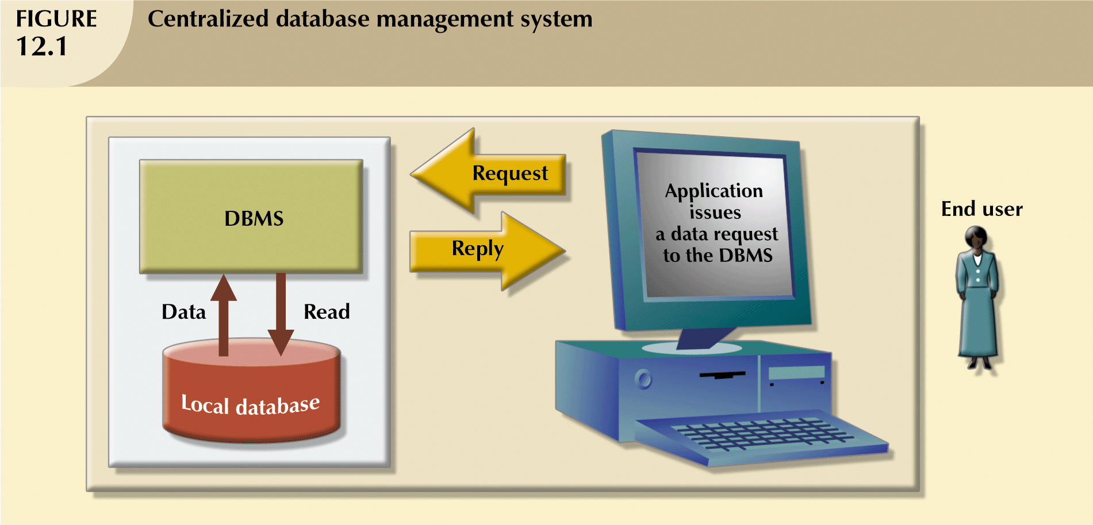
The Evolution of Distributed Database Management Systems

Slide 5
Introduction to Distributed Database - Definition
Distributed Database
  A single logical database spread physically across computers in multiple locations that are connected by a data communications link
  A logically interrelated collection of shared data (and a description of this data), physically distributed over a computer network.

Slide 6
Introduction to Distributed Database - Definition
Distributed DBMS
  Software system that permits the management of the distributed database and makes the distribution transparent to users.

Slide 7
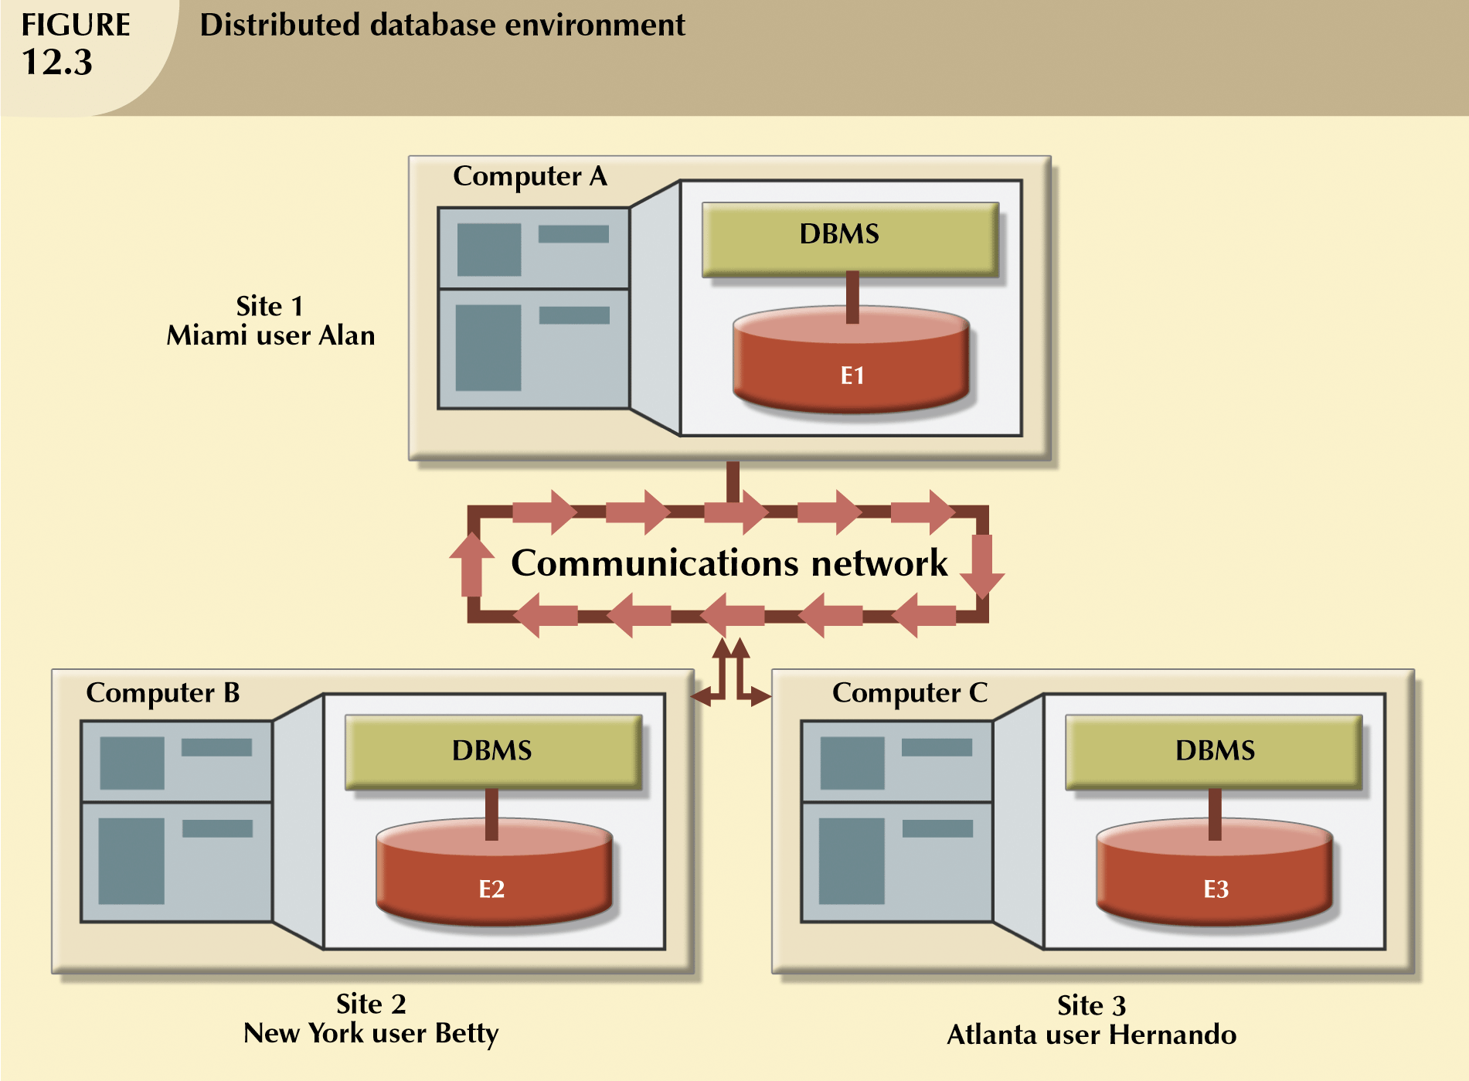
Introduction to Distributed Database

Slide 8
Objectives
To provide ease of access to data for users at many different locations
  Location Transparency
    User does not have to know the location of the data
    Data requests automatically forwarded to appropriate sites
  Local Autonomy
    Local site can administer and operate with its database when network connections fail
    Each site controls its own data, security, logging, recovery

Slide 9
4 basic strategies
Data replication
  Copies of data distributed to different sites
  Database replication: the process of copying and maintaining database objects, such as relations, in multiple databases that make up a distributed database system
Horizontal partitioning
  Different rows of a table distributed to different sites
Vertical partitioning
  Different columns of a table distributed to different sites
Combinations from the above

Slide 10
Advantages of Distributed Database over Centralized Database
Increased reliability/availability
Local control over data
Modular growth
Lower communication costs
Faster response for certain queries
Faster data processing

Slide 11
Disadvantages of Distributed Database over Centralized Database
Software cost and complexity
Processing overhead
Data integrity exposure
Slower response for certain queries

Slide 12
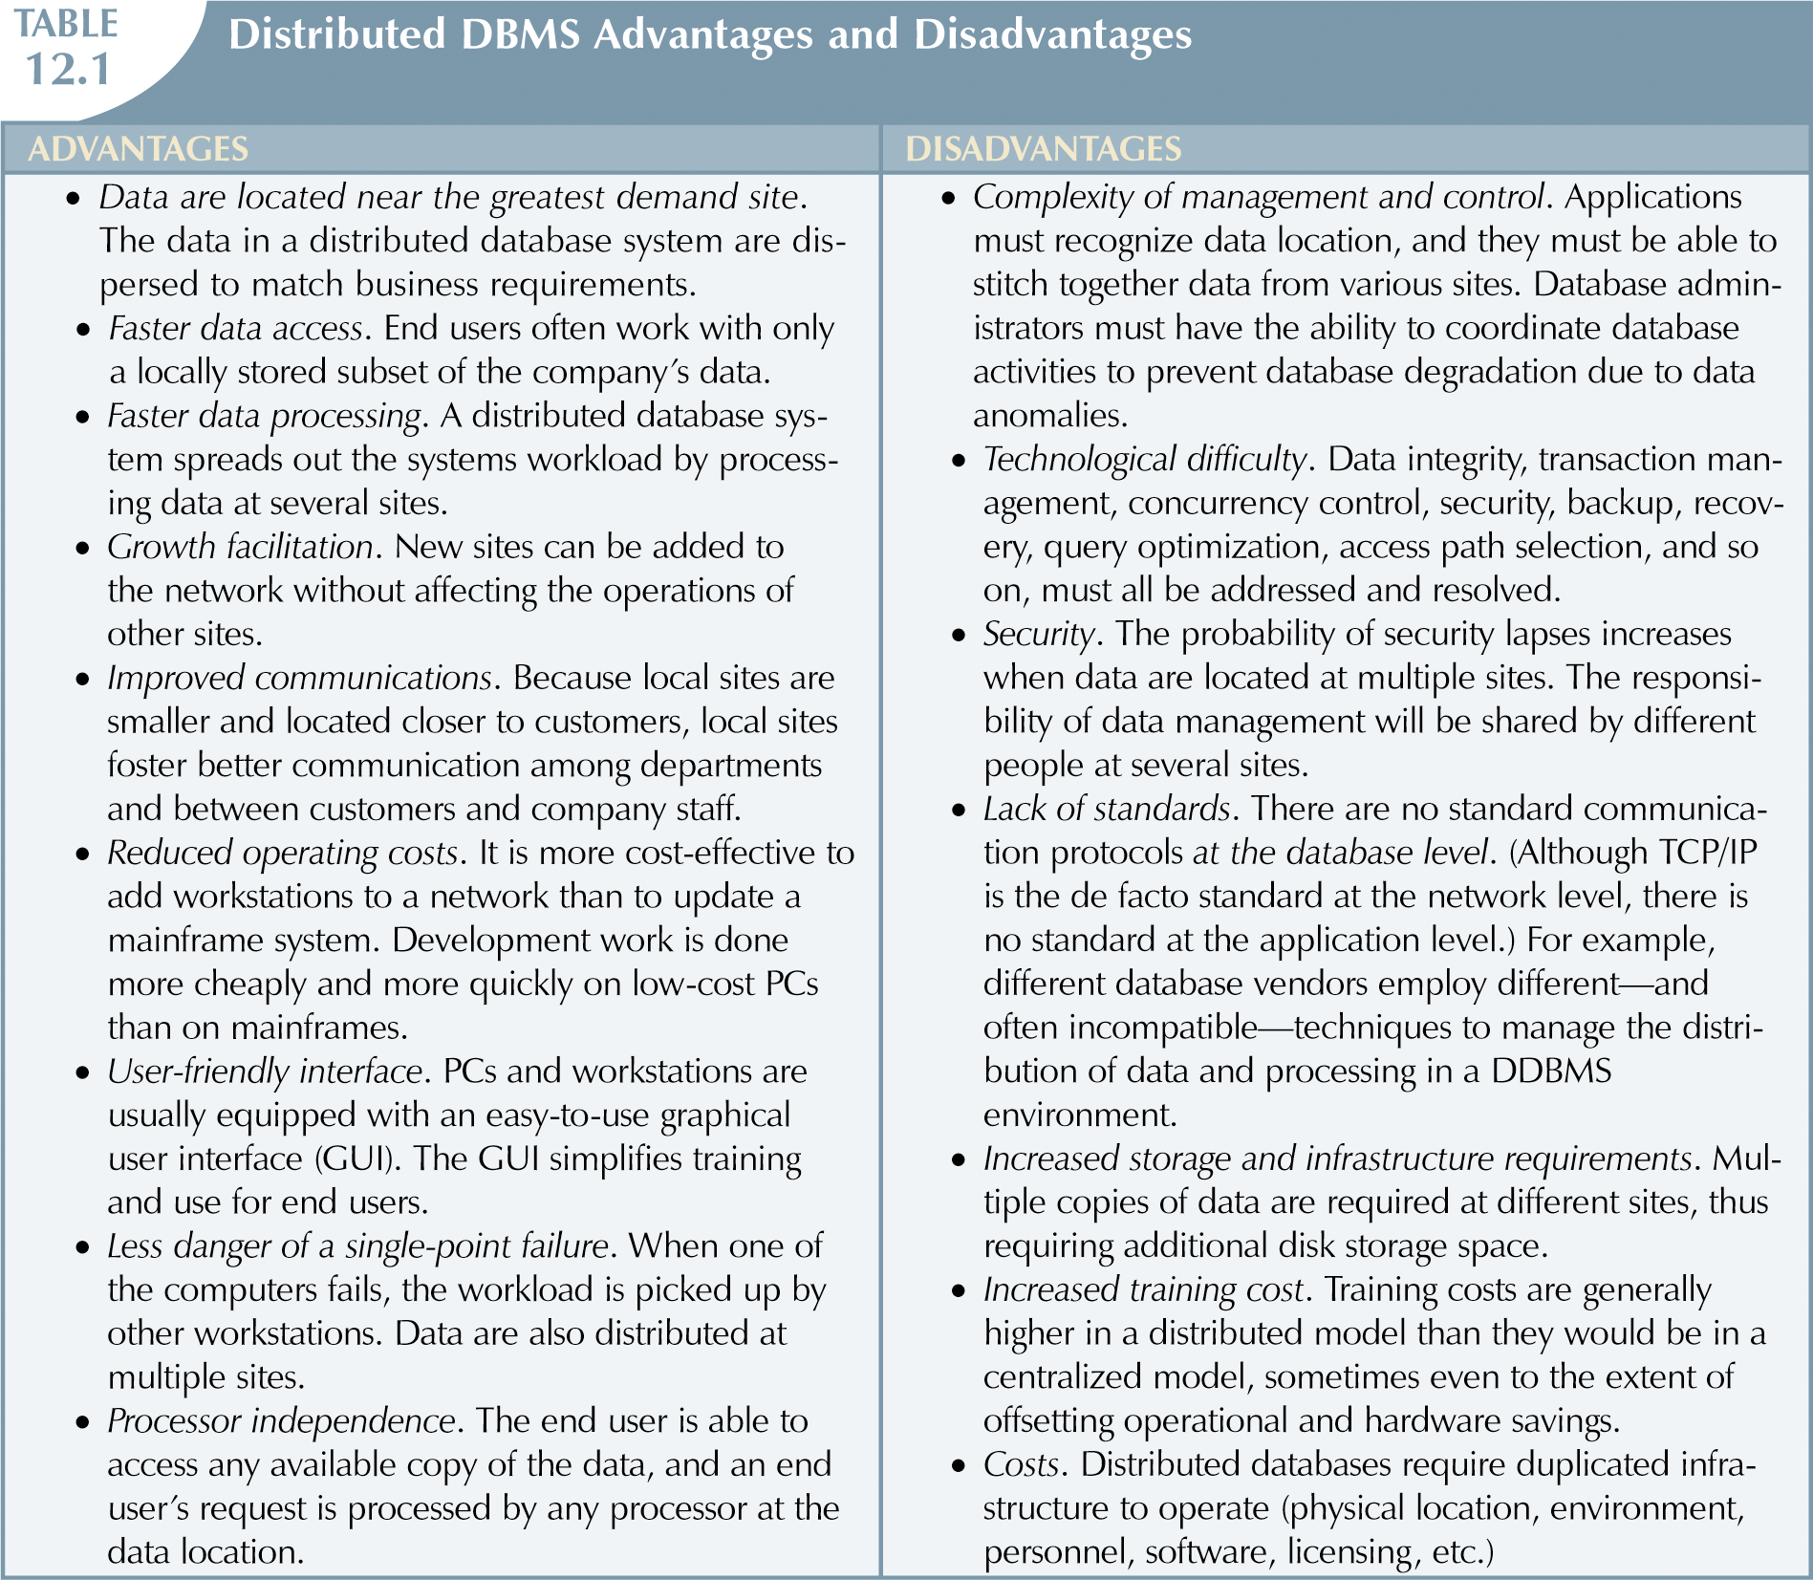

Slide 13
OBJECT ORIENTED DATABASE MODEL
DCI3023 – DATABASE / DCI2033 – DATABASE SYSTEM

Slide 14
Introduction to Object Oriented Database
Centers around objects and classes
Involves inheritance
Encapsulates both data and behavior
Benefits of Object-Oriented Modeling
  Ability to tackle challenging problems
  Improved communication between users, analysts, designers, and programmers
  Increased consistency in analysis, design, and programming
  Explicit representation of commonality among system components
  System robustness
  Reusability of analysis, design, and programming results

Slide 15
OO vs EER Data Modeling
Object Oriented
EER
Class
Entity type
Object
Entity instance
Association
Relationship
Inheritance of attributes
Inheritance of attributes
Inheritance of behavior
No representation of behavior

Slide 16
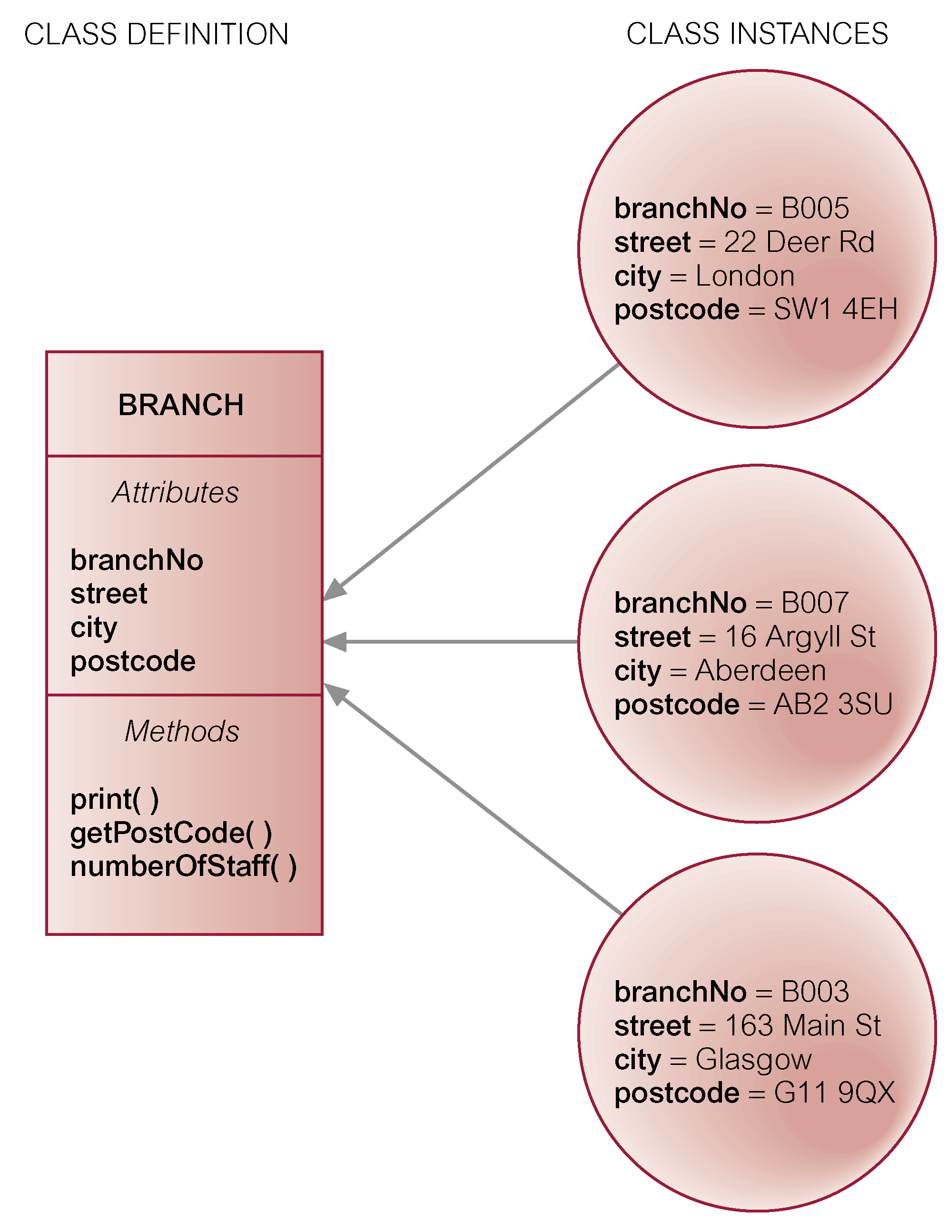
Example – class instance share attributes and methods

Slide 17
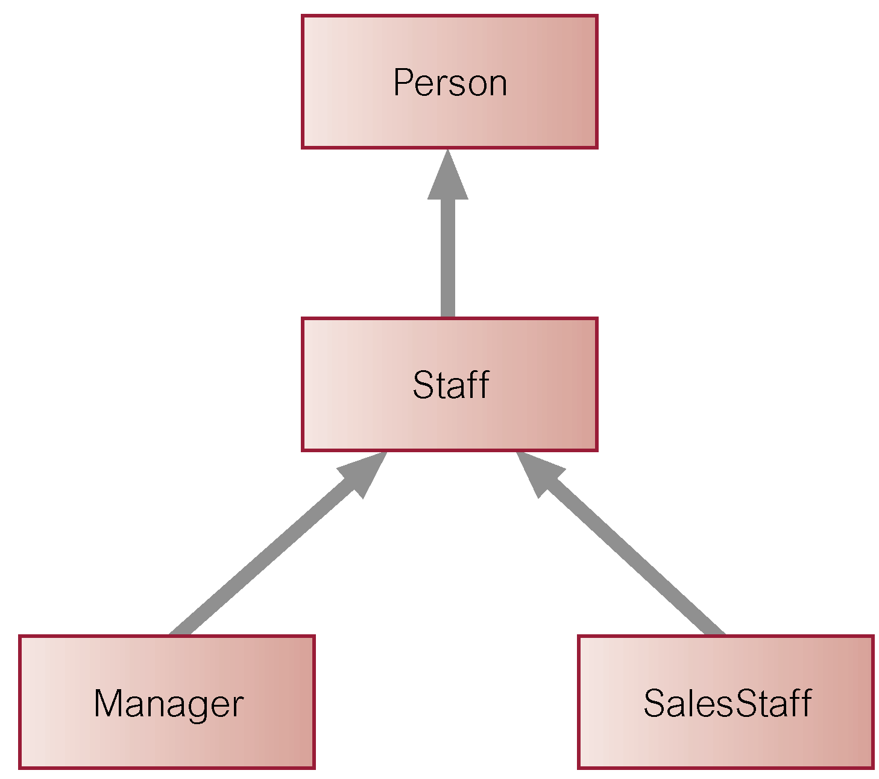
Example –Single Inheritance

Slide 18
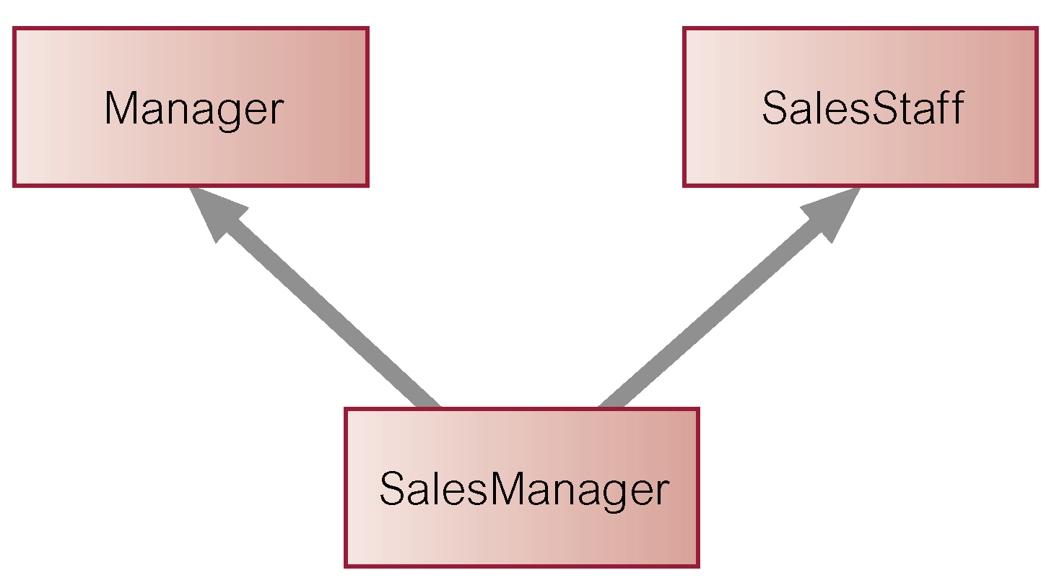
Example – Multiple Inheritance

Slide 19
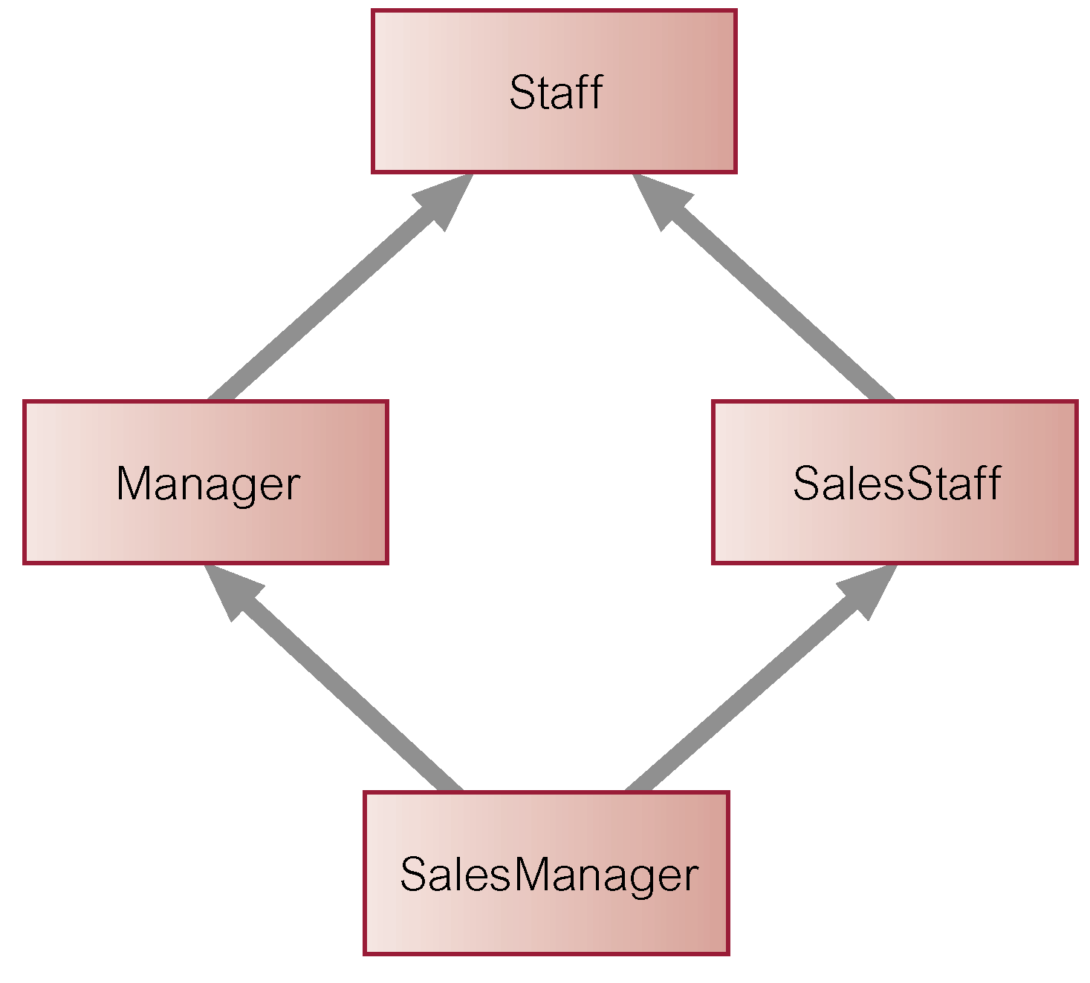
Example – Repeated Inheritance

Slide 20
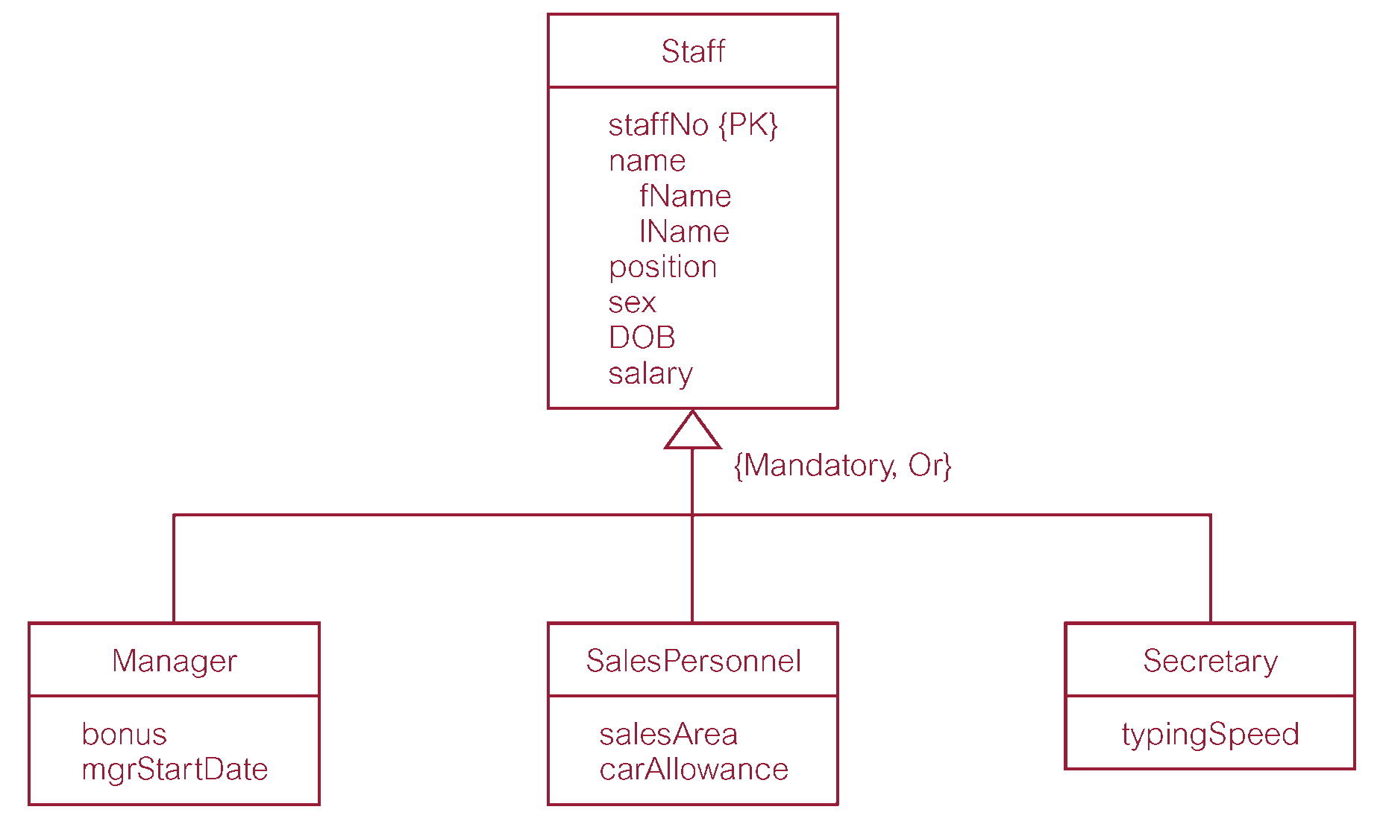
Storing Objects in Relational Databases

Slide 21
Number of strategies for mapping classes to relations, although each results in a loss of semantic information.
  Map each class or subclass to a relation:
    Staff (staffNo, fName, lName, position, sex, DOB, salary)
    Manager (staffNo, bonus, mgrStartDate)
    SalesPersonnel (staffNo, salesArea, carAllowance)
    Secretary (staffNo, typingSpeed)

Slide 22
Cont
  Map each subclass to a relation
  Manager (staffNo, fName, lName, position, sex, DOB, salary, bonus, mgrStartDate)
  SalesPersonnel (staffNo, fName, lName, position, sex, DOB, salary, salesArea, carAllowance)
  Secretary (staffNo, fName, lName, position, sex, DOB, salary, typingSpeed)
  Map the hierarchy to a single relation
  Staff (staffNo, fName, lName, position, sex, DOB, salary, bonus, mgrStartDate, salesArea, carAllowance, typingSpeed, typeFlag)

Slide 23
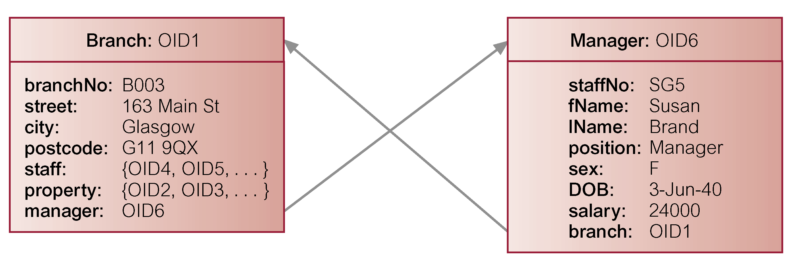
Relationships
1:1 Relationship Between Objects A and B
  Add reference attribute to A and, to maintain referential integrity, reference attribute to B.

Slide 24
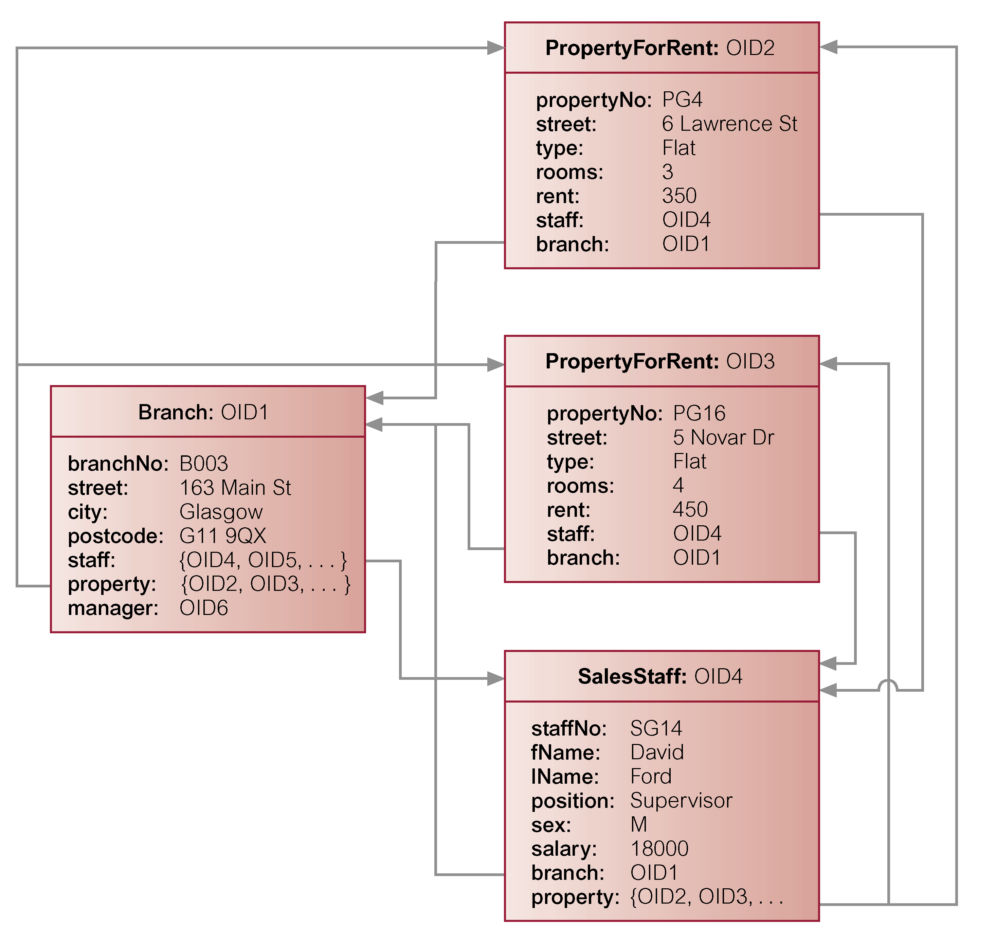
Relationships
1:* Relationship Between Objects A and B
  Add reference attribute to B and attribute containing set of references to A.

Slide 25
Relationships
*:* Relationship Between Objects A and B
  Add attribute containing set of references to each object.
  For relational database design, would decompose *:N into two 1:* relationships linked by intermediate entity. Can also represent this model in an ODBMS.

Slide 26
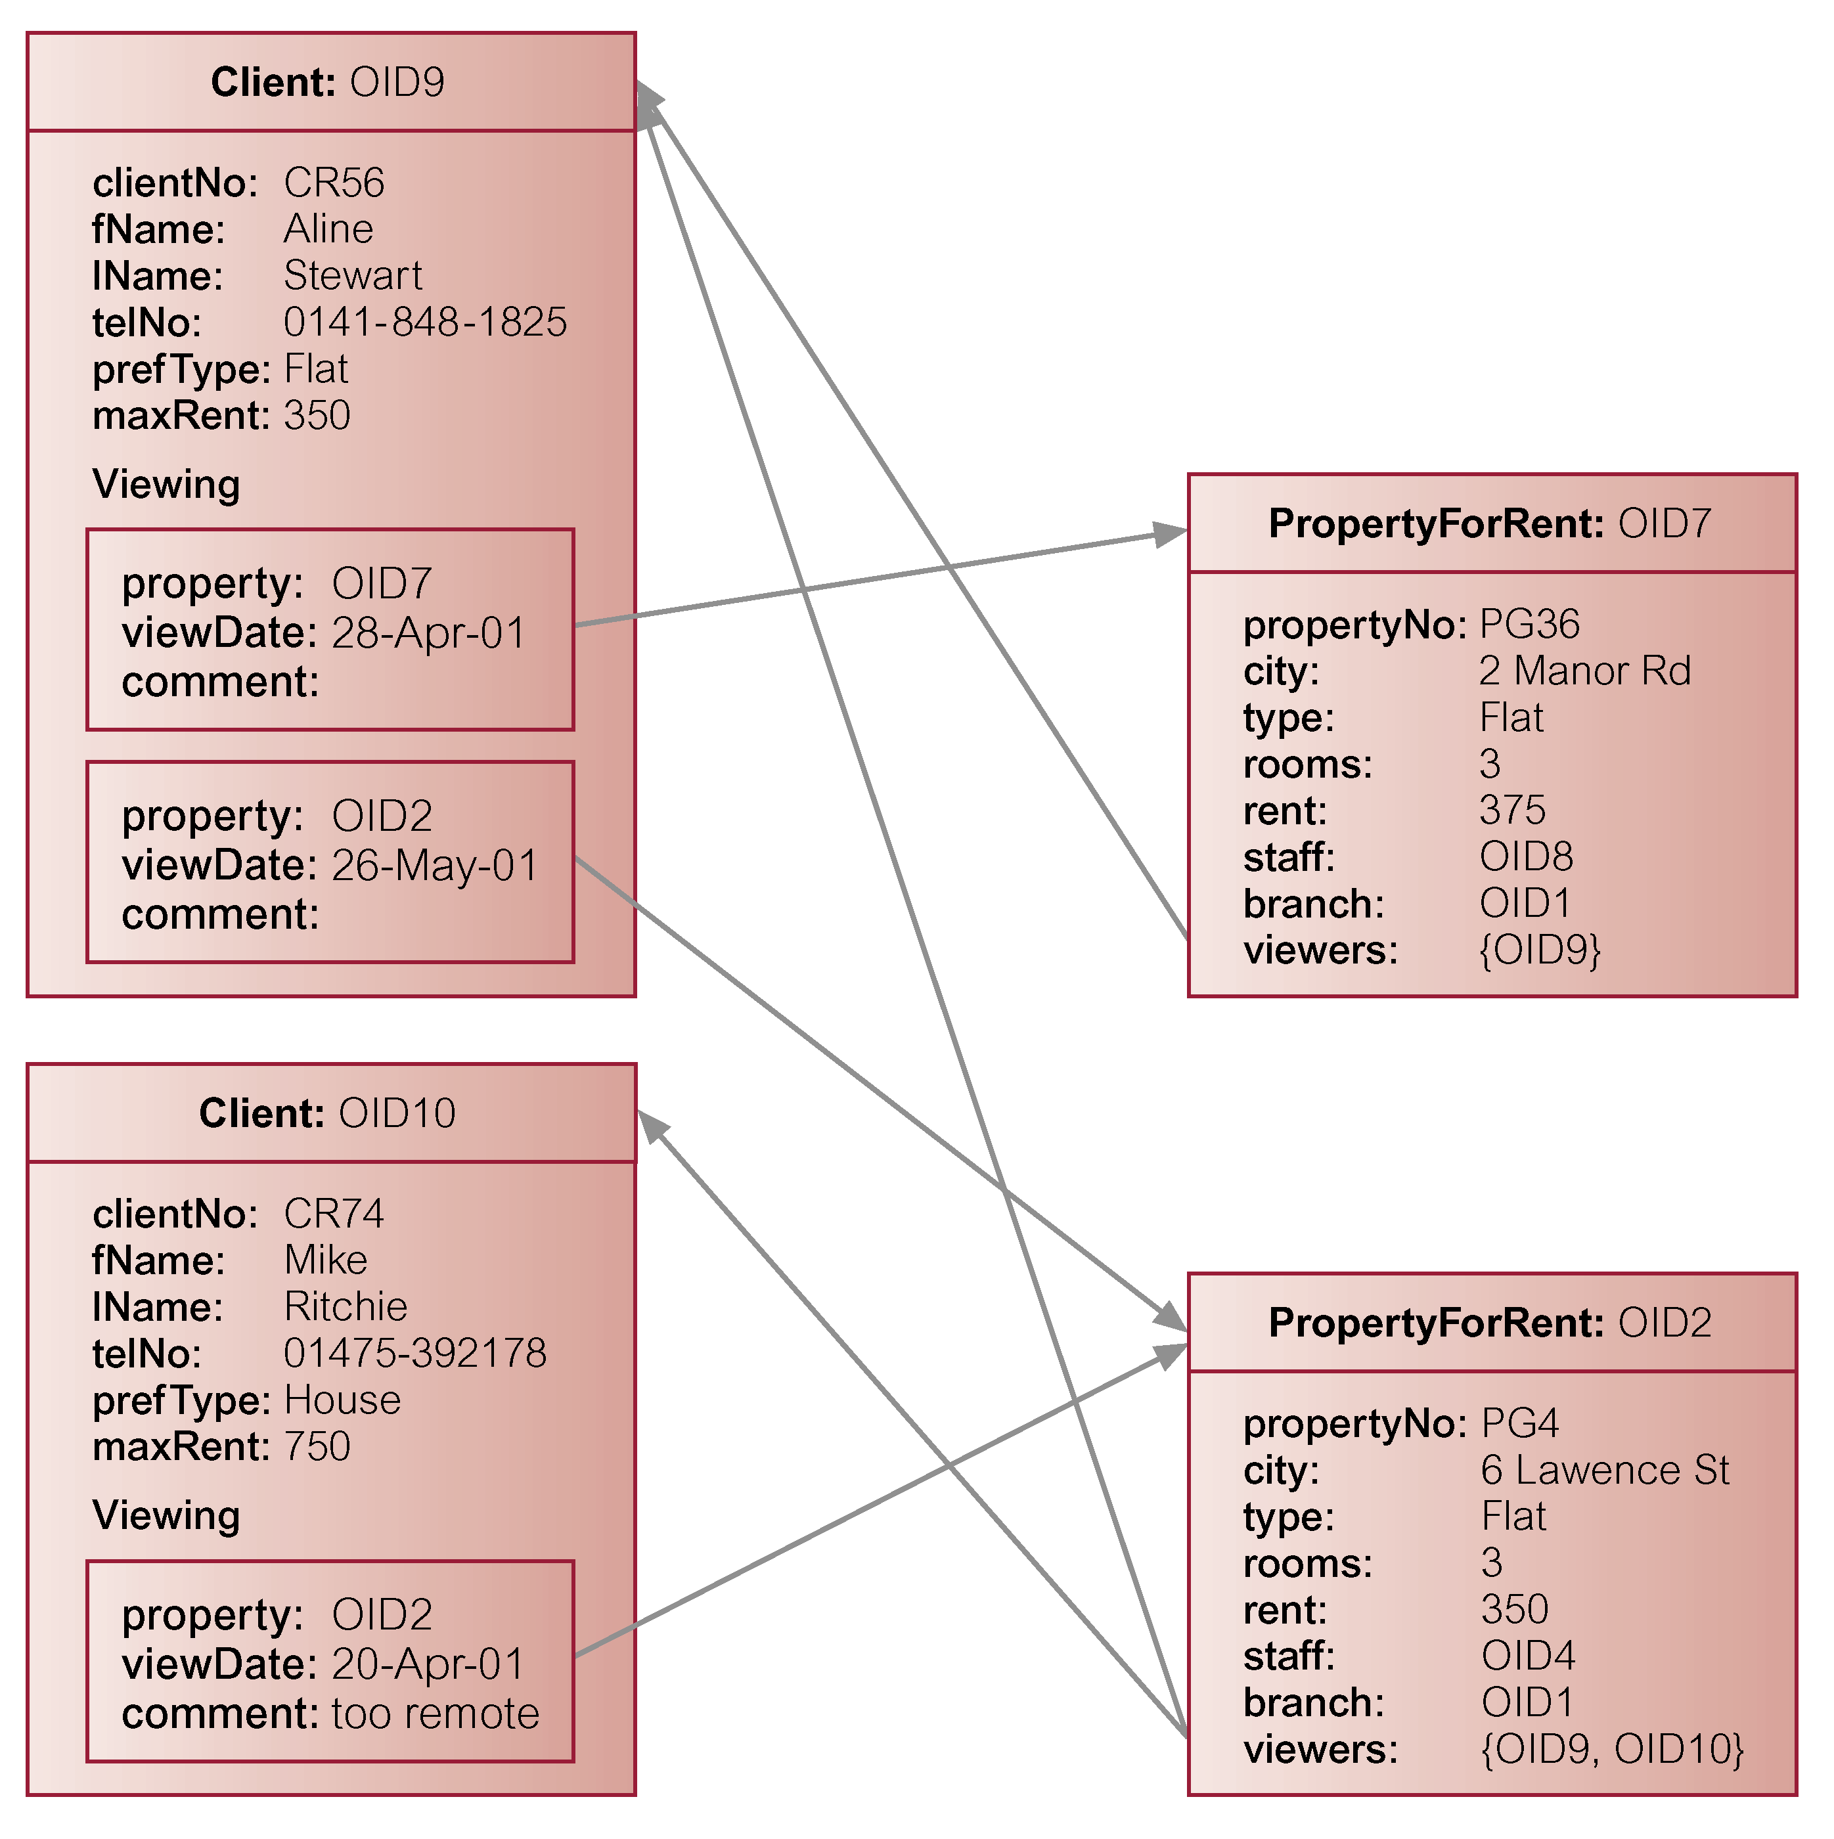
Relationships
*:* Relationship

Slide 27
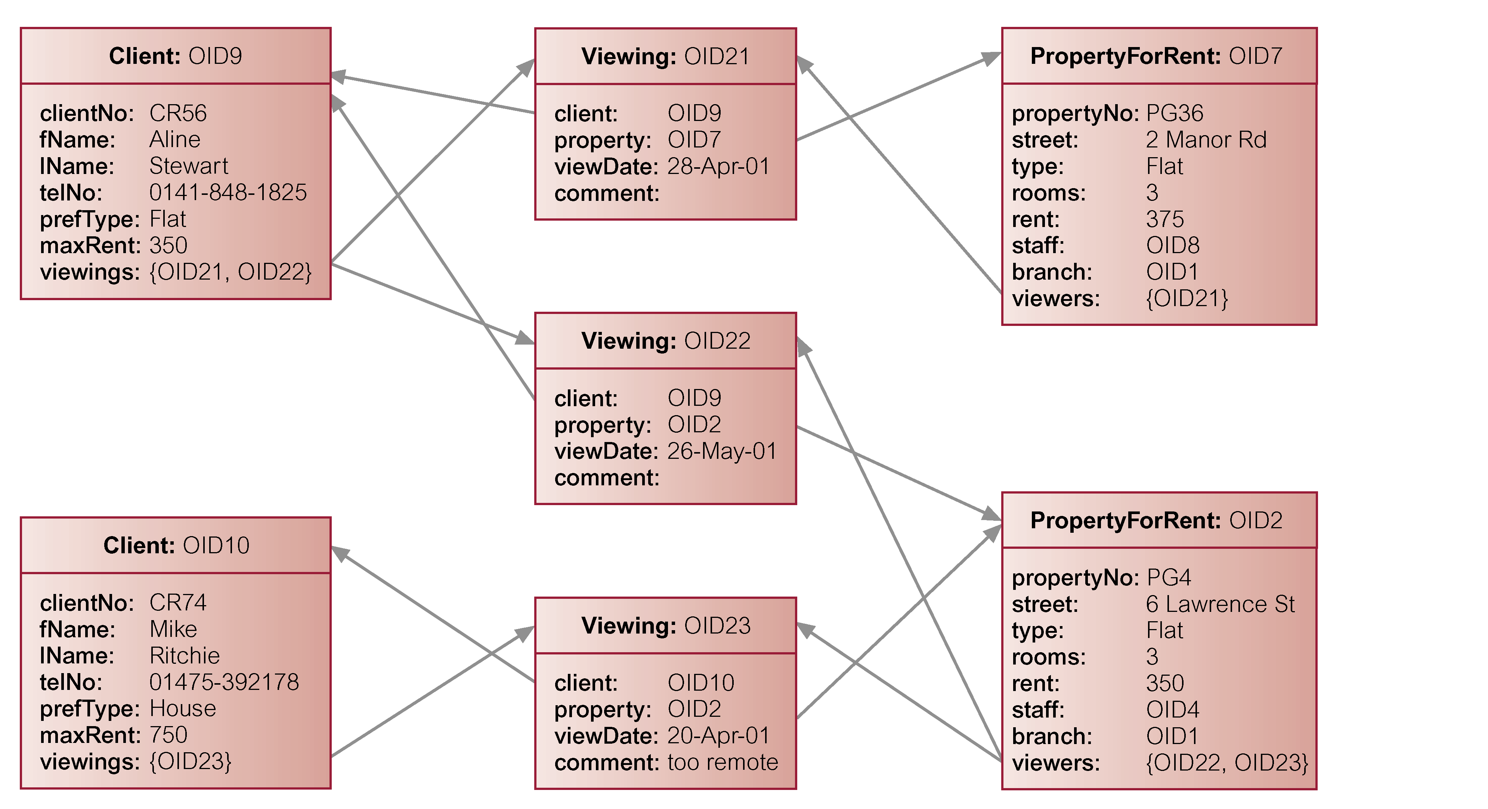
Alternative Design for *:* Relationships

